Slide 1
CGI work today
PhaseEquilibria (uses the Thomson and Clausius-Clapeyron equations you derived yesterday)
FreezingPtDepression (about reconciling Raoult’s Law with Blagden’s Law)

Slide 2

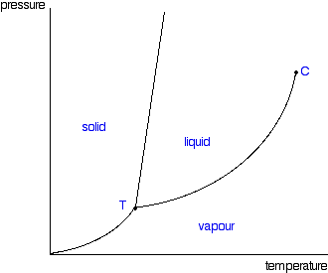

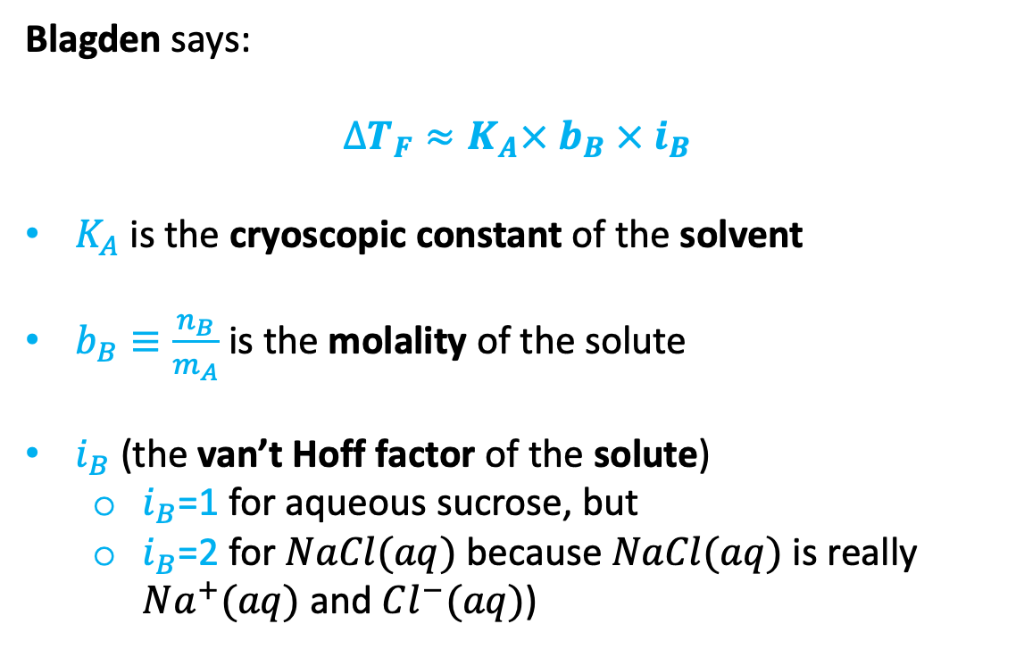


Blagden’s Law for freezing point depression
Blagden says:
$$∆T_{F}≈K_{A}× b_{B} × i_{B}$$
$K_{A}$ is the cryoscopic constant of the solvent
$b_{B}≡\frac{n_{B}}{m_{A}}$ is the molality of the solute
$i_{B}$ (the van’t Hoff factor of the solute)
$i_{B}$=1 for aqueous sucrose, but
$i_{B}$=2 for $NaCl(aq)$ because $NaCl(aq)$ is really $Na^{+}(aq)$ and $Cl^{−}(aq)$)
P
$$P_{A}^{∗}$$
$$P_{A}$$
$$∆T_{F}$$
T
Hypothesis: there’s a connection between Blagden and Raoult.
How to explore that hypothesis: use ${P_{A}=P}_{A}^{∗}χ_{A}$ to deduce $∆T_{F}≈K_{A}× b_{B} × i_{B}$.

Slide 3
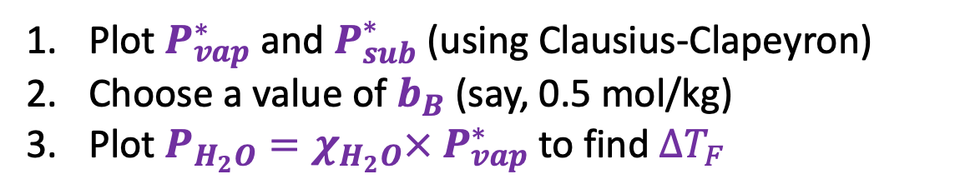


Using Raoult’s Law to deduce Blagden’s Law
P
Plot $P_{vap}^{∗}$ and $P_{sub}^{∗}$ (using Clausius-Clapeyron)
Choose a value of $b_{B}$ (say, 0.5 mol/kg)
Plot $P_{H_{2}O}=χ_{H_{2}O}×{ P}_{vap}^{∗}$ to find $∆T_{F}$
$$P_{A}^{∗}$$
$$P_{A}$$
$$∆T_{F}$$
T

Slide 4
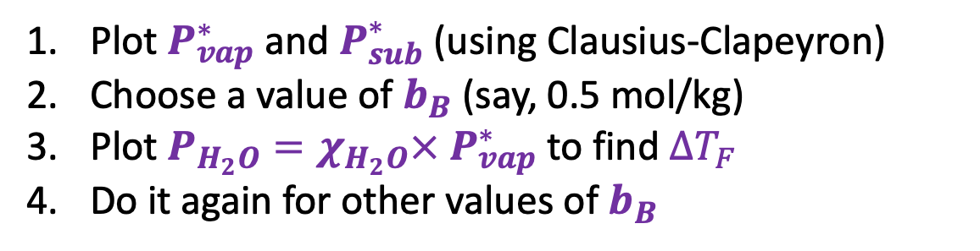
Using Raoult’s Law to deduce Blagden’s Law
P
Plot $P_{vap}^{∗}$ and $P_{sub}^{∗}$ (using Clausius-Clapeyron)
Choose a value of $b_{B}$ (say, 0.5 mol/kg)
Plot $P_{H_{2}O}=χ_{H_{2}O}×{ P}_{vap}^{∗}$ to find $∆T_{F}$
Do it again for other values of $b_{B}$
$$P_{A}^{∗}$$
$$P_{A}$$
$$∆T_{F}$$
T

Slide 5
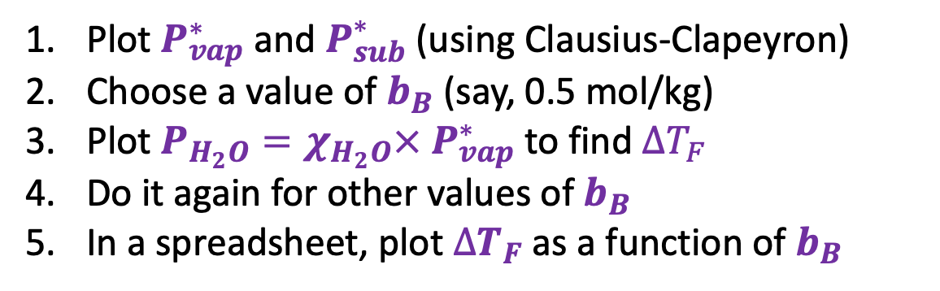


Using Raoult’s Law to deduce Blagden’s Law
P
Plot $P_{vap}^{∗}$ and $P_{sub}^{∗}$ (using Clausius-Clapeyron)
Choose a value of $b_{B}$ (say, 0.5 mol/kg)
Plot $P_{H_{2}O}=χ_{H_{2}O}×{ P}_{vap}^{∗}$ to find $∆T_{F}$
Do it again for other values of $b_{B}$
In a spreadsheet, plot $∆T_{F}$ as a function of $b_{B}$
$$P_{A}^{∗}$$
$$P_{A}$$
$∆T_{F}$
$$∆T_{F}$$
T
$$b_{B}$$

Slide 6
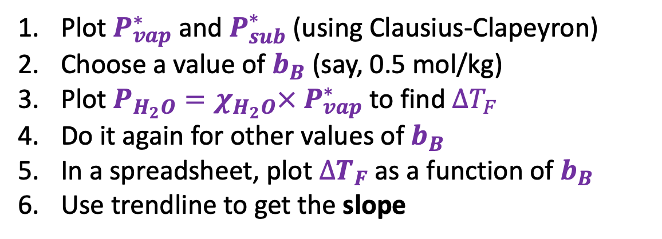
Using Raoult’s Law to deduce Blagden’s Law
P
Plot $P_{vap}^{∗}$ and $P_{sub}^{∗}$ (using Clausius-Clapeyron)
Choose a value of $b_{B}$ (say, 0.5 mol/kg)
Plot $P_{H_{2}O}=χ_{H_{2}O}×{ P}_{vap}^{∗}$ to find $∆T_{F}$
Do it again for other values of $b_{B}$
In a spreadsheet, plot $∆T_{F}$ as a function of $b_{B}$
Use trendline to get the slope
$$P_{A}^{∗}$$
$$P_{A}$$
$∆T_{F}$
$$∆T_{F}$$
T
$$b_{B}$$

Slide 7

Using Raoult’s Law to deduce Blagden’s Law
P
Plot $P_{vap}^{∗}$ and $P_{sub}^{∗}$ (using Clausius-Clapeyron)
Choose a value of $b_{B}$ (say, 0.5 mol/kg)
Plot $P_{H_{2}O}=χ_{H_{2}O}×{ P}_{vap}^{∗}$ to find $∆T_{F}$
Do it again for other values of $b_{B}$
In a spreadsheet, plot $∆T_{F}$ as a function of $b_{B}$
Use trendline to get the slope
$$P_{A}^{∗}$$
$$P_{A}$$
$$∆T_{F}≈K_{A}× b_{B} × i_{B}$$
$∆T_{F}$
$$∆T_{F}$$
T
$$b_{B}$$

